Slide 1
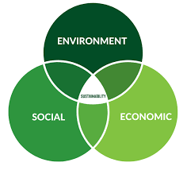
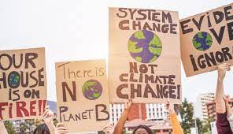
Sustainable Consumer Behavior: Influences, Challenges, and Opportunities
Brendan Oh

Slide 2

Introduction
Overview
Unpacking the trends, drivers, and challenges that shape the choices consumers make in support of a more sustainable future.
Importance:
Understanding the pivotal role consumers play in influencing businesses and driving positive environmental and social impact.
Objectives:
Explore the psychological factors shaping sustainable choices.
Discuss the role of technology, policy, and emerging trends in shaping the future of sustainable consumer behavior

Slide 3
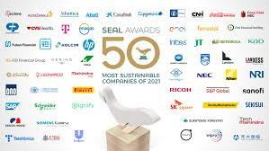
Current Landscape
Global Awareness Impact:
Increasing awareness of environmental and social issues shaping consumer behavior globally.
Consumer Expectations Shift:
Growing expectation for businesses to prioritize sustainability; 57% of consumers willing to change habits for the environment (Nielsen).
Mainstreaming Sustainability:
Rise in demand for eco-friendly products, indicating a shift from niche to mainstream consumer behavior.
Corporate Commitments

Slide 4


Drivers of Change
Eco-Consciousness Rise
Ethics and CSR Influence
Awareness of Global Issues
Innovations in Sustainable Products

Slide 5
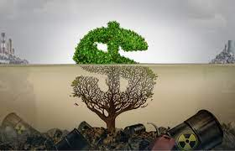
Challenges and Barriers
Greenwashing Concerns:
Greenwashing poses a challenge, with consumers wary of deceptive sustainability claims by businesses.
Affordability Hurdle
Lack of Information
Resistance to Change
Consumer resistance to change ingrained habits represents a significant barrier in fostering sustainable behaviors

Slide 6
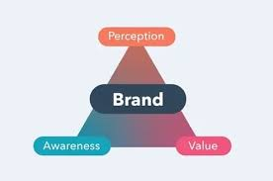
Psychological Influences
Values Driving Choices:
Personal values play a significant role, influencing consumer choices towards sustainable options aligned with their beliefs.
Social Norms Impact
Brand Perception
Consumers associate sustainability with positive brand perception, influencing purchasing decisions and loyalty.
Emotional Connection

Slide 7


Technology and Sustainable Consumption
Tech-Enabled Awareness
E-Commerce Convenience
Innovative Apps Influence
Digital Communication Impact

Slide 8
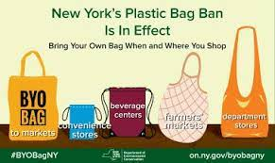
Policy and Regulation
Government Impact:
Government policies, like plastic bans and emission standards, significantly influence sustainable consumer behavior by shaping regulations that drive environmental responsibility.
International Agreements:
International agreements, such as the Paris Agreement, create a global framework influencing national policies and corporate sustainability initiatives.
Local Initiatives
Regulatory Push for Transparency:
Mandatory eco-labeling, ensures consumers have access to clear information, fostering informed sustainable choices.

Slide 9

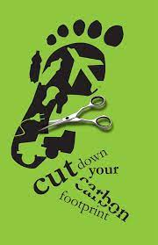
Recommendations
Education and Awareness Campaigns:
Implement robust education and awareness campaigns to inform consumers about sustainable choices, fostering a deeper understanding of the environmental impact.
Affordability Strategies
Incentivize Sustainable Practices:
Introduce incentives for both businesses and consumers to engage in sustainable practices, creating a positive reinforcement loop.

Slide 10
Relevancy
Global Citizenship Development
Career Readiness:
Understanding sustainable practices is increasingly valued by employers. Integrating this knowledge prepares college students for careers that prioritize environmental and social responsibility.
Personal Empowerment:
Knowledge of sustainable consumer behavior empowers college students to make informed choices, aligning their values with their purchasing decisions and lifestyle.
Campus Impact and Leadership:
College students, as a demographic, have significant collective influence. Learning about sustainability enables them to lead impactful initiatives on campus and contribute to positive change in their community.

Slide 11
References
Antonetti, P., & Maklan, S. (2014). An extended model of moral outrage at corporate social irresponsibility. Journal of Business Ethics, 131(1), 25-38. https://link.springer.com/article/10.1007/s10551-014-2275-8
Auger, P., Devinney, T. M., Louviere, J. J., & Burke, P. F. (2008). Do social product features have value to consumers? International Journal of Research in Marketing, 25(3), 183-191. https://www.sciencedirect.com/science/article/pii/S0167811608000414
Bloemer, J., de Ruyter, K., and Peeters, P. (1998). Investigating drivers of bank loyalty: the complex relationship between image, service quality and satisfaction. International Journal of Bank Marketing, 16(7), 276-286. https://doi.org/10.1108/02652329810245984
Boston Consulting Group. (2021). The Consumer Sustainability Journey. Retrieved from https://www.bcg.com/publications/2021/the-consumer-sustainability-journey
Boulstridge, E., & Carrigan, M. (2000). Do Consumers Really Care About Corporate Responsibility? Highlighting the Attitude-Behavior Gap. Journal of Communication Management, 4(4), 355-368. https://www.emerald.com/insight/content/doi/10.1108/13632540010804546/full/html
Field, A. (2023, April 26). Study Finds An Inflection Point In Consumers’ Green Buying Behavior. Forbes. https://www.forbes.com/sites/annefield/2023/04/26/study-finds-an-inflection-point-in-consumers-green-buying-behavior/?sh=3cfe63cf686e

Slide 12
References cont.
Gwozdz, W., Reisch, L. A., & Thøgersen, J. (2020). Behaviour Change for Sustainable Consumption. Journal of Consumer Policy. https://doi.org/10.1007/s10603-020-09455-z
Kim, Y., & Choi, S. M. (2020). Drivers to green consumption: a systematic review. Journal of Cleaner Production, 267, 1220882. https://link.springer.com/article/10.1007/s10668-020-00844-5
Luchs, M. G., Naylor, R. W., Irwin, J. R., & Raghunathan, R. (2010). The Sustainability Liability: Potential Negative Effects of Ethicality on Product Preference. Journal of Marketing, 74(5), 18-31. https://www.journals.ama.org/doi/abs/10.1509/jmkg.74.5.18
Milfont, T. L., & Markowitz, E. (2016). Sustainable consumer behavior: A multilevel perspective. Current Opinion in Psychology, 10, 112–117. https://doi.org/10.1016/j.copsyc.2015.12.016
Pappas, S. (2021, June 1). The goods on consumer behavior. Monitor on Psychology, 52(4). https://www.apa.org/monitor/2021/06/feature-consumer-behavior
Ramadhan Wiloso. (2022). Sustainable Consumer Behavior: A Review. HUMANIS: Journal of Communication, 6(2), 1-103. https://psycnet.apa.org/record/2023-90829-001
Szegedi, K. (2023). Shifting sands: How consumer behaviour is embracing sustainability. Deloitte. https://www2.deloitte.com/ch/en/pages/consumer-business/articles/shifting-sands-sustainable-consumer.html
Talapatra, J. (2022). Impact of Changing Consumer Behaviour on Sustainability. Responsible Leadership and Sustainable Management, 109–127. https://doi.org/10.1007/978-981-16-7614-7_8
Universitat Pompeu Fabra, Barcelona School of Management. (2022). Sustainable Consumer Behavior. Retrieved from https://www.bsm.upf.edu/en/news/sustainable-consumer-behavior
White, K., Hardisty, D. J., & Habib, R. (2019). The Elusive Green Consumer. Harvard Business Review. https://hbr.org/2019/07/the-elusive-green-consumer

